Slide 1

Karthik, Daksh and Vaishant Present

Slide 2
SINCE THE DAWN OF TIME MANKIND HAS TRIED TO PREDICT THE VALUE OF COMMODITIES

Slide 3
Can today’s reddit posts be used to predict tomorrow’s opening stock price?
Tl;dr, yes.

Slide 4
How did we do it? Magic. *
*data science

Slide 5
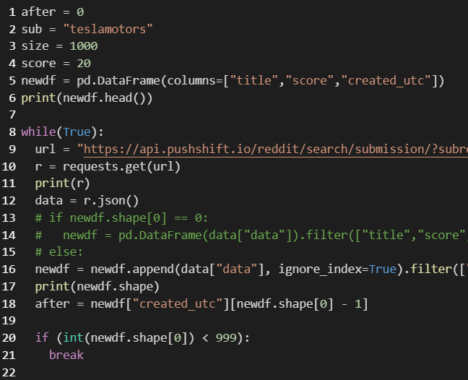
First, we collected the data.
Reddit’s API is straight garbage
With a little digging we found push shift on Github.
It limited us to 999 posts per request, and we needed over 30,000 posts.
We then
made a script to sequentially download posts using epoch time comparison
Parse for timestamped text

Slide 6
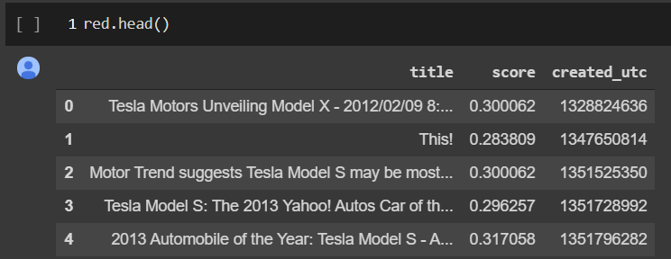
First, we collected the data.
Reddit’s API is straight garbage
With a little digging we found push shift on Github.
It limited us to 999 posts per request, and we needed over 30,000 posts.
We then
made a script to sequentially download posts using epoch time comparison
Parse for timestamped text

Slide 7
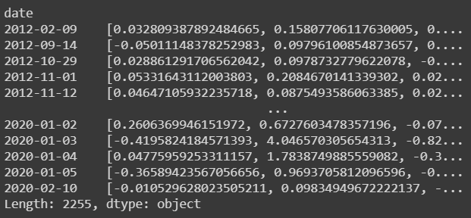
Natural Language Processing
Vectorized every day’s posts into a 300-dimensional vector
Placed the timestamped vector into a data-frame

Slide 8

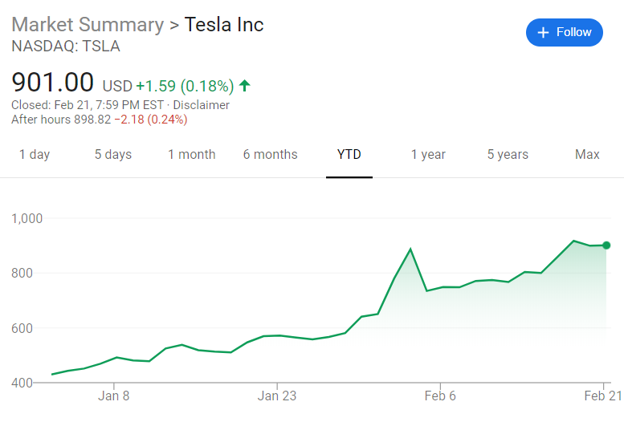
Getting Financial Data
This wasn’t that hard
AlphaVantage API

Slide 9
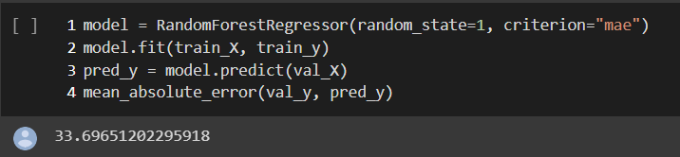
Training the Model
Used a Gradient Booster and a RandomForestRegressor
RFR yielded a mean absolute error of 33.70 while predicting stock prices with a train-test split with very limited optimization, on a data with a standard deviation of over 69.

Slide 10
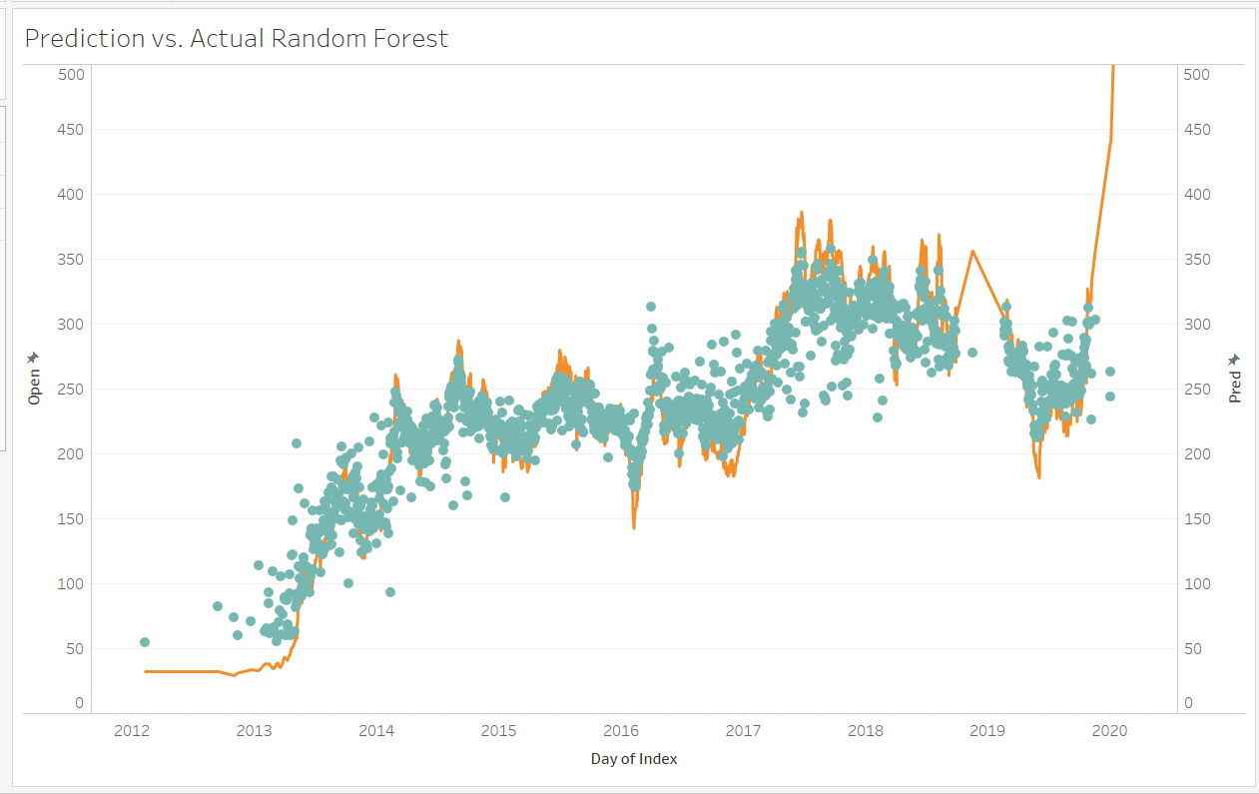

Slide 11
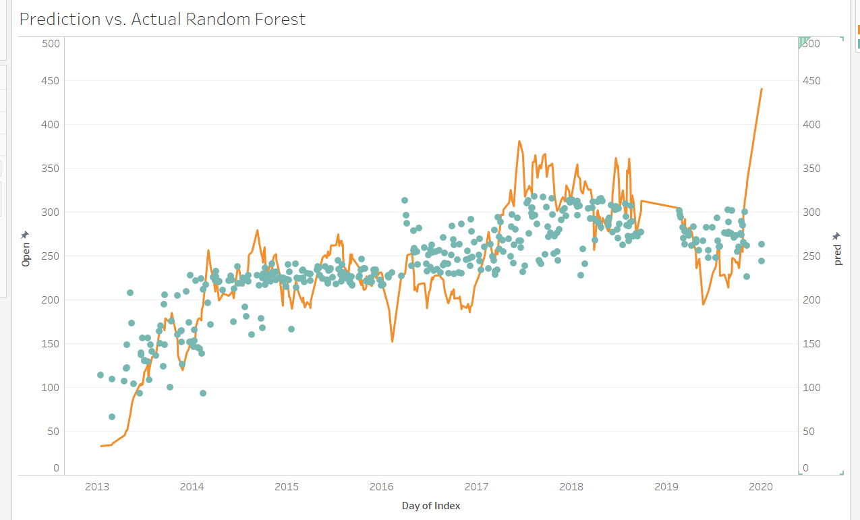

Slide 12
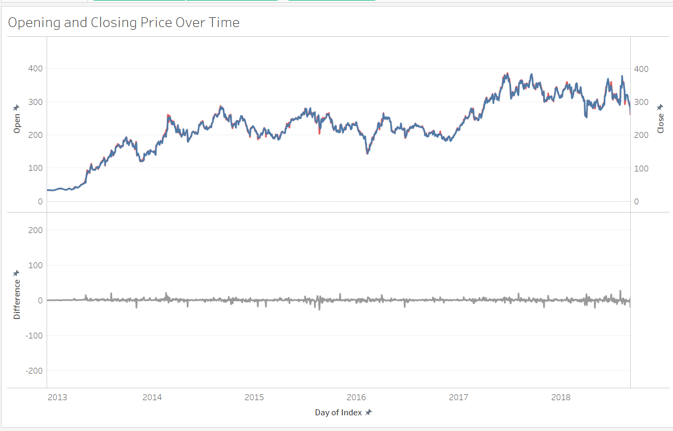

Slide 13
Therefore,
today’s reddit posts can be used to predict tomorrow’s opening stock price.

